Slide 1
Lecture 5
Gradient Descent Learning

Slide 2
The Supervised Learning Problem
Training Set
Fit a model:
to minimize the loss function
by adapting the parameters

Slide 3
Loss Functions
The three most commonly used loss functions are:
Absolute Error:
Mean-Squared Error (MSE):
Cross-Entropy Loss:
Used for binary (0/1) desired outputs and sigmoid actual outputs

Slide 4
The Error Surface
For most non-trivial problems, the error surface is very complicated and has many local minima.
local
minimum
global
minimum
local
minimum

Slide 5
Iterative Optimization
Present data points from the training set one at a time to the model.
Calculate the loss for each data point.
Modify the parameters:
a) After each step (on-line mode)
or
b) after going through many data points (batch mode)
such that:
Training Epoch:
Usually, one pass through all the training data. In some cases, only a subset of the data may be seen in any given epoch.

Slide 6
On-Line Mode:
An alternative is to use a repeat…until instead of for so that the # of learning steps depends on the performance rather than a preset value.

Slide 7
Batch Mode:

Slide 9
Gradient Descent Optimization

Slide 10
Intuitive Explanation:
If you are trying to get to the bottom of a valley, the fastest way down is to go down the steepest slope at every step.
The gradient vector points up the steepest slope at every point.
Thus, going in the opposite direction of the gradient is the steepest way down.

Slide 11
Stochastic Gradient Descent (Online)
Note that, ideally, gradient descent training of a network requires:
where
i.e., the gradient must be calculated over all
data summed together, using weights from
epoch T.
This can be problematic for very large data-sets
Solution: Train in on-line mode, selecting data points randomly from the data-set
at each step, and updating immediately.
Stochastic gradient descent
is used widely in applications
of supervised learning to
big data, including
deep learning.

Slide 12
Stochastic Gradient Descent (Minibatch)
Divide up each epoch into several minibatches of data (random or regular).
Average gradient over each minibatch and adjust weights.
Obviously, this can also be run in repeat …. until mode instead of a for loop with a pre-specified number of epochs.

Slide 13
Active Management of Training Data
- Use examples on which error is greater.
Use examples that are very different from those already used
(to cover new regions of sample space)
- Randomize the order of presentation.
Weight probability of presentation for different classes.
Watch out for outliers that can really skew the weights catastrophically.
Use multiple, overlapping training and testing sets.

Slide 14
Gradient Descent with Momentum
Original gradient descent update:
Gradient descent with momentum:
If |α| ≥ 1, the equation can become unstable.
What does momentum do?
if has the same sign for several
consecutive iterations
stable downhill direction for w_{i}
momentum increases descent rate
if has alternating signs over
consecutive iterations
w_{i} is not contributing much to descent
momentum damps movement in w_{i}

Slide 15
Without momentum, is not contributing to progress. This is indicated by its oscillating sign.
w₂
w₁
With momentum, is damped and increased
to find minimum faster
w₂
Momentum magnifies progress in directions of sustained descent and diminishes progress in other directions
w₁

Slide 16
The Adam (Adaptive Moment) Algorithm
Kingma & Ba (2015) ADAM: A Method for Stochastic Optimization, Proc. ICLR 2015
Elementwise
product
raised to
power t
Elementwise
ratio
Recommended choices:

Slide 17
Simple Neuron Model
x₀ = 1
w_{i0}
x₁
w_{i1}
x₂
w_{i2}
Σ
s_{i}
f
y_{i}
w_{i3}
x₃
x_{n}
w_{in}
Activation
Function
Composition
Function

Slide 18
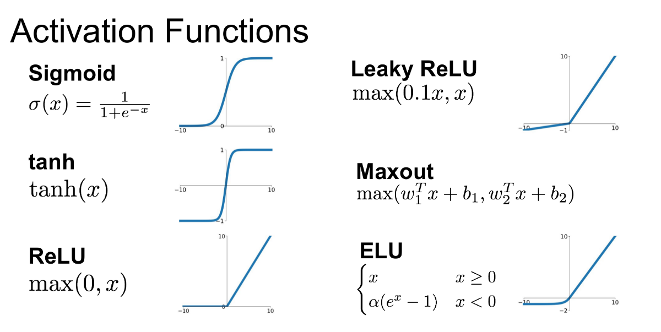
Activation Functions
Why use ReLU?
Source: https://www.quora.com/
It is nonlinear and monotonic (both useful/necessary)
Its gradient does not vanish on the positive side (unlike sigmoids).
It gives infinite range of output values (0 to +∞)
But
ReLU gradient vanishes on negative side → Leaky ReLU
ReLU is non-differentiable at 0 → ELU (exponential linear unit)

Slide 19
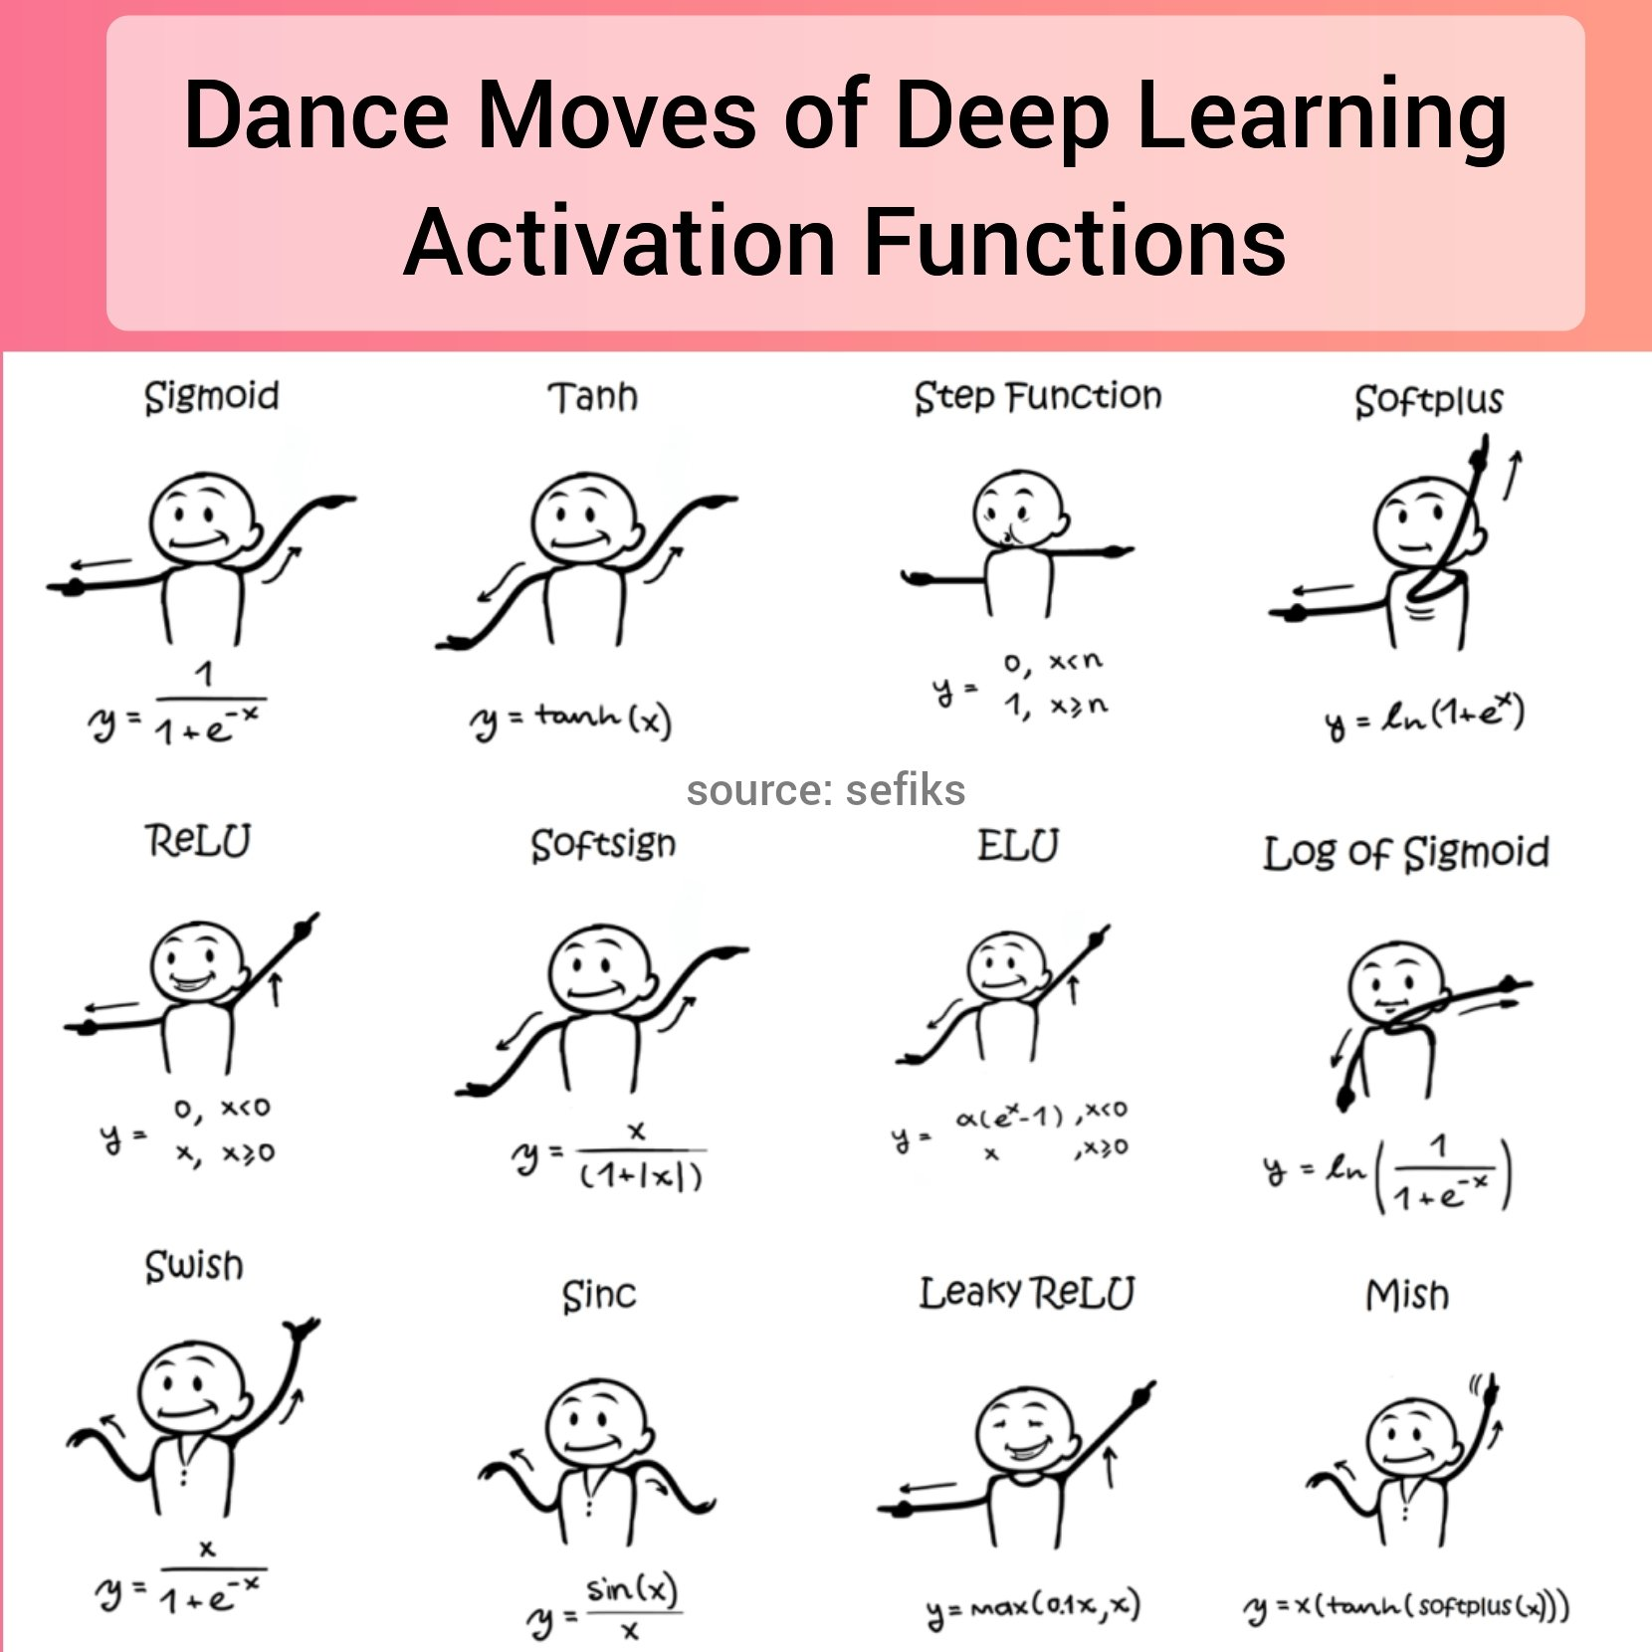

Slide 20
The Least Mean Square (LMS) Algorithm
Consider a single layer of neurons
w₁₀
w₁₁
x₁
1
w₁₂
w₂₀
x₂
2
w_{l0}
w_{1n}
x_{n}
l

Slide 21
bias
bias weight

Slide 22
Typical f(u)
f(u)
Threshold
u
f(u)
Sigmoid
u
f(u)
ReLU
u

Slide 23
p = index of units.
p = 1, . . . , l
superposition
of derivatives

Slide 25
Note that the error terms are dissociated from others, so we can use any differentiable error metric without changing the algorithm.

Slide 26
And any activation function – as long as it is differentiable

Slide 28
Sigmoid f(u)

Slide 29
Linear f(u)
which is the perceptron learning rule.

